Slide 1
SRS Sadria Society Bishuddho Bishyaon Somobay Sommittee
Prepared by : Md Yasin Arif
Supervised by : Rajaul Islam
Technology : Java Swing & MySQL

Slide 2
Requirements
Sadria Society Bishuddho Bishyaon Somobay Sommittee wants to develop there all Financial transaction using a Desktop Application. They want to record all there members and investors information (personal & transaction). Overview there whole deposit and investment and print individual statement.

Slide 3
Requirements analysis
Create Saving A/C
Create Investment A/C
Record Transaction
Summary of transaction
Print Statement
Overview of Deposit and Investment

Slide 4
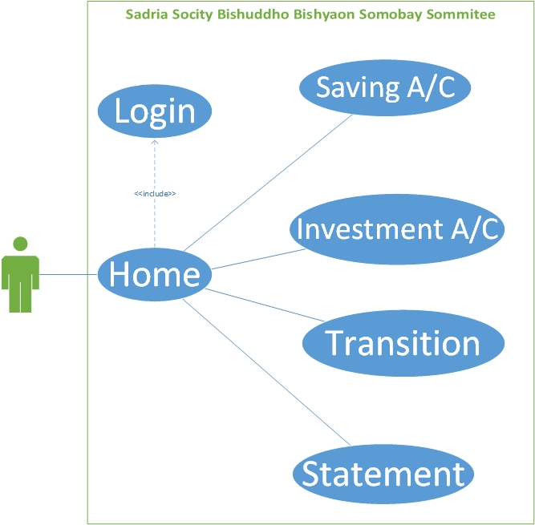
Use Case

Slide 5
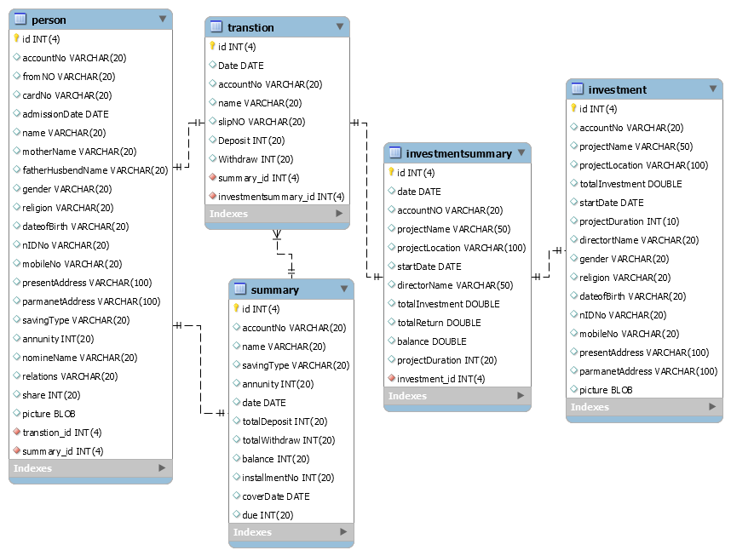
Class Diagram

Slide 6
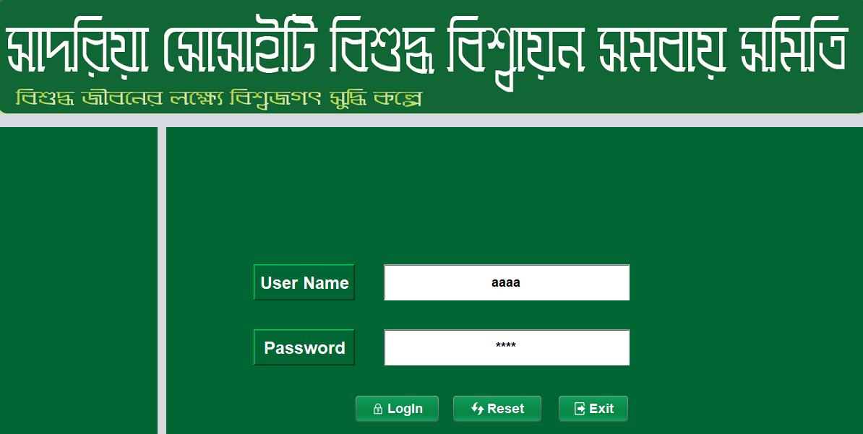
Login Page

Slide 7
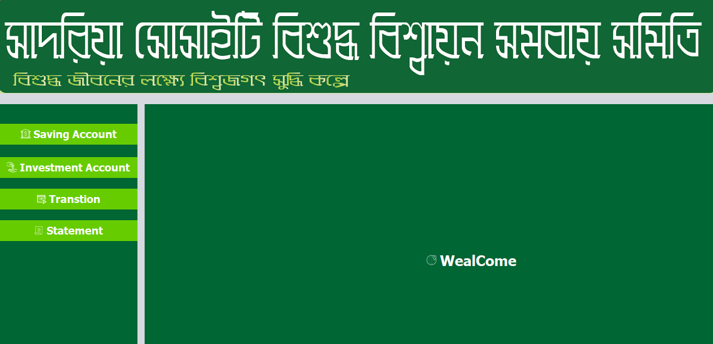
Home Page

Slide 8
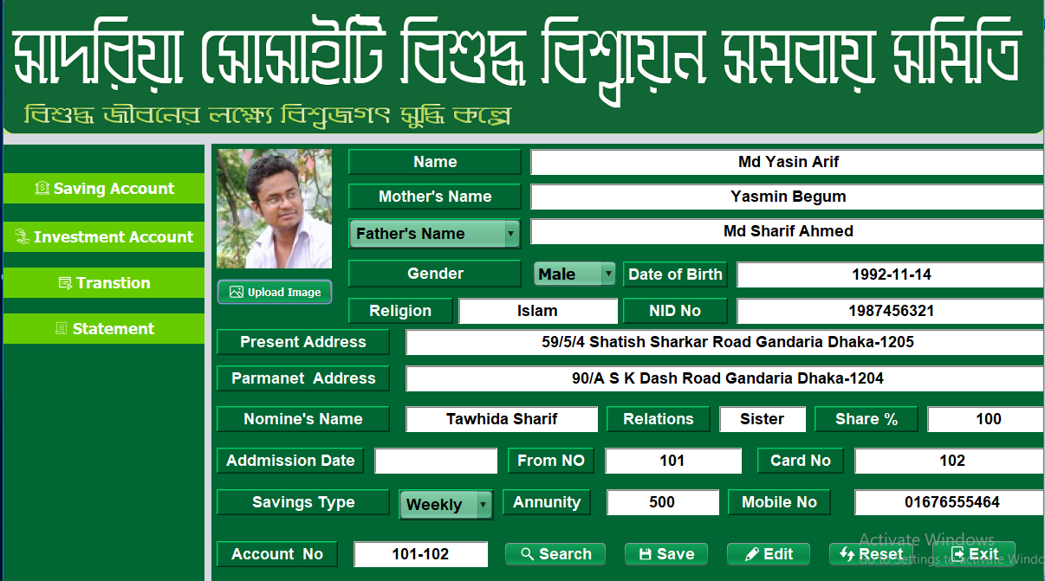
Saving A/C

Slide 9
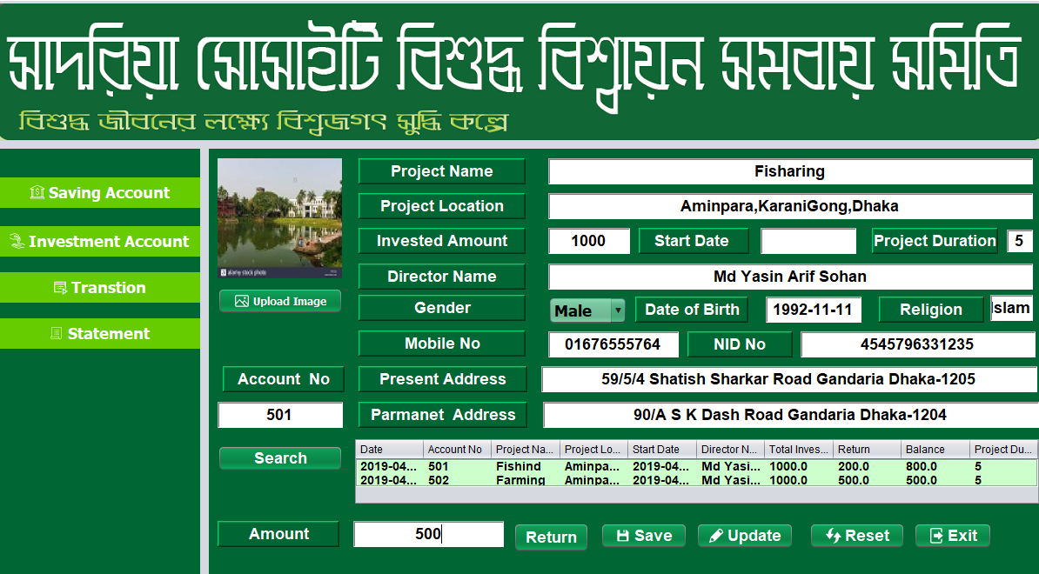
Investment A/C

Slide 10
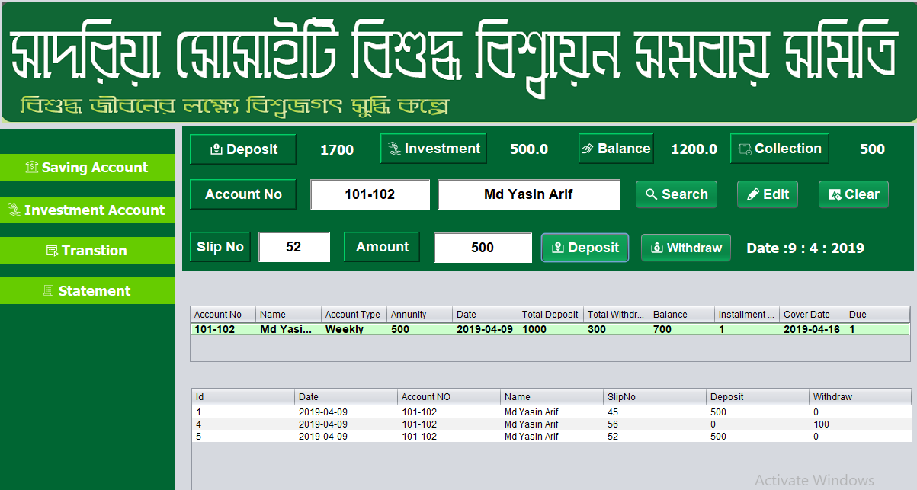
transaction

Slide 11
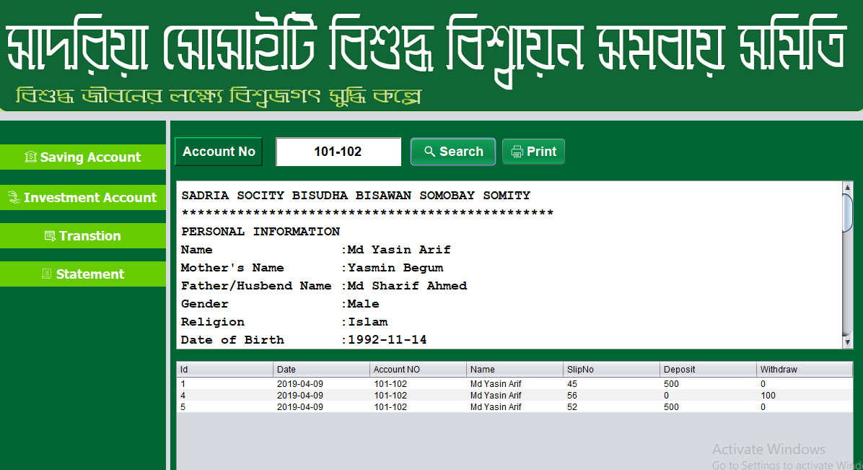
Statement

Slide 12
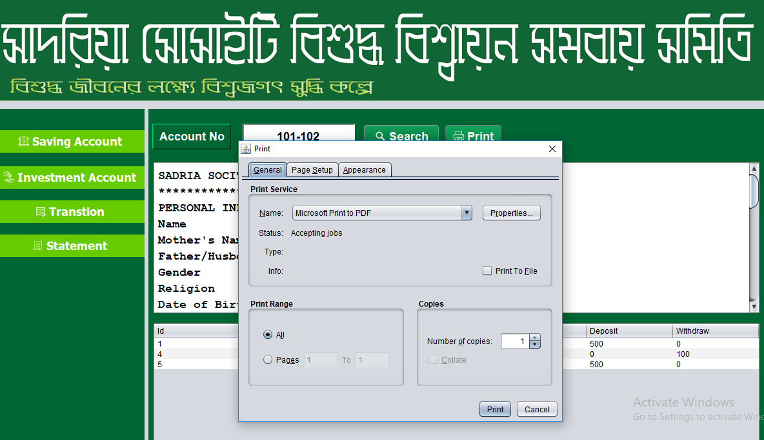
Print Statement

